Slide 1

Libya Higher Education Forum
A vision for new systems
Mathew Boice, Vice President Middle East & Africa, Ellucian

Slide 2




Improving – Rating, Ranking, Acreditation
What ranking are we looking at?
Which metrics are relevant?
Establishing institutional imperatives?
Setting goals and objectives?
Complex systems and tools that are difficult to use
Meetings arguing over the right data, not deciding what to do about it
Hoarding vs. sharing information

Slide 3
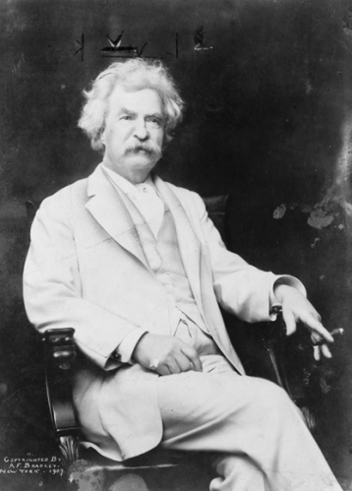
“
“
An institution that has good data and does nothing with it has no advantage over an institution that has no data.
The man who does not read good books has no advantage over the man who can't read them.
”
”

Slide 4
Turning Data & Reports Into Action
Institutional Performance
Management
DATA
ACTION
Systems of Record
COMMON BLACKHOLE “Systems of Insight”
Systems of Engagement
Inaction, Institutional Misalignment, Inefficient, Lack of Results

Slide 5
Where is your Student Data Stored?
Manual filing system
In a spreadsheet or in manual records
We have a University database
for student records

Slide 6
How do Students Register for Courses?
In a queue around the administrative building
On a mobile device or tablet
They don’t – there are no course choices
to make – so we register them!

Slide 7
How Many Students are Enrolled?
A large number I believe but my
reports never have consistent data
That depends on who is asking!
Let’s get the students to raise
their hands?

Slide 8
Should Libya Build Data Centres in all Universities?
Yes - I’d like to see the stuff I am buying
No – let’s build a major facility and share it
No – let’s use something already
existing outside the country

Slide 9
Does the University have the Capability to Implement new Systems?
Yes – we have done this
before and are ready to go
Yes – but our people need coaching,
training & guidance
No – we do not have an organisational
capacity for projects at all

Slide 10
Do we need a Libyan Enrolment Process?
Yes – we are unique & only a
tailored process will work
No – we can use an established
best practice from elsewhere
What do you mean by an
enrolment process?

Slide 11
Turning Data & Reports Into Action
Institutional Performance
Management
DATA
ACTION
Systems of Record
COMMON BLACKHOLE “Systems of Insight”
Systems of Engagement
Inaction, Institutional Misalignment, Inefficient, Lack of Results

Slide 13
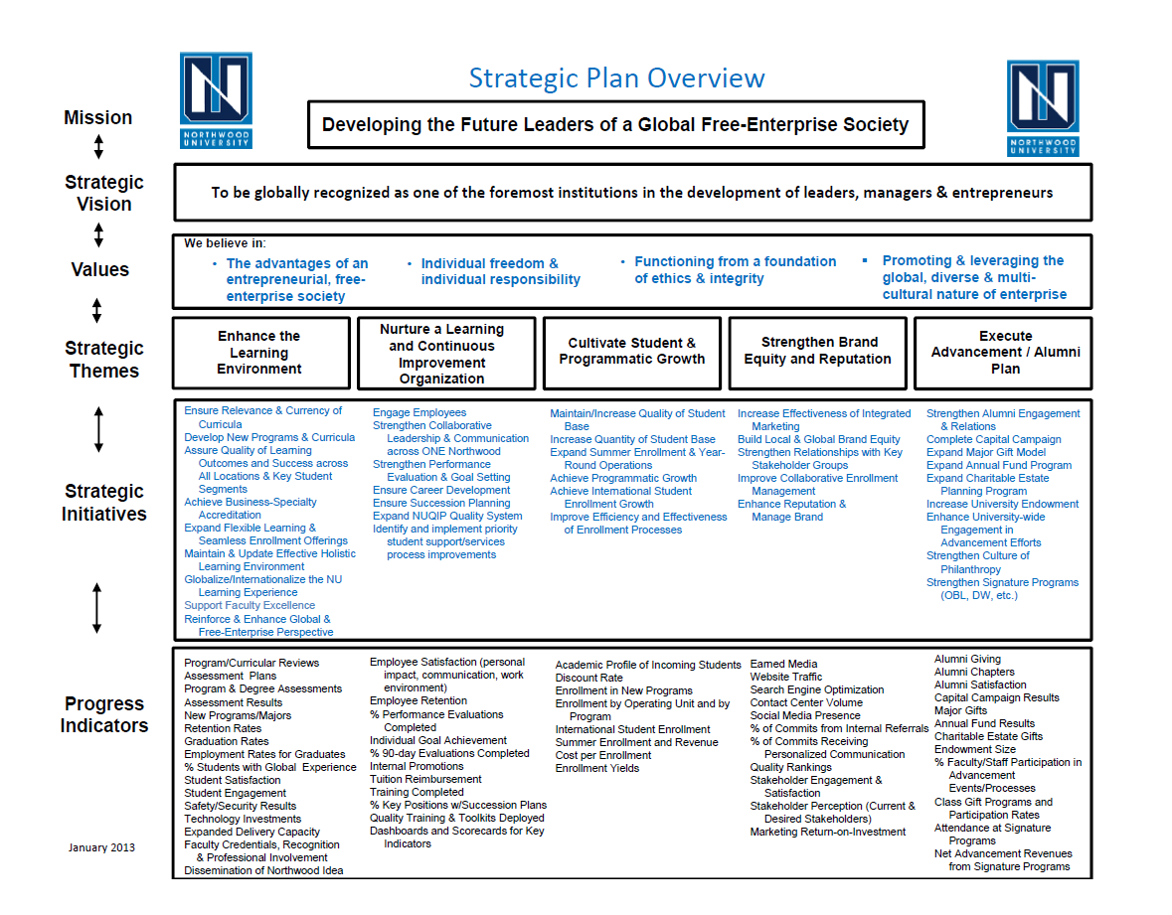
Northwood University Strategic Plan Overview

Slide 14
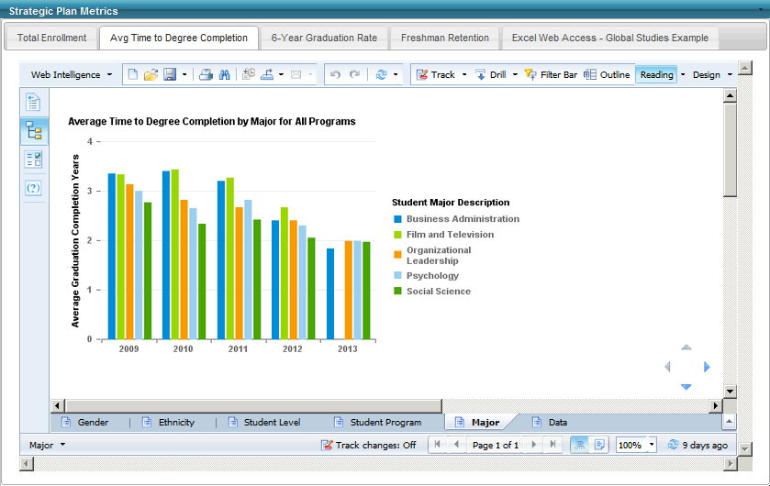
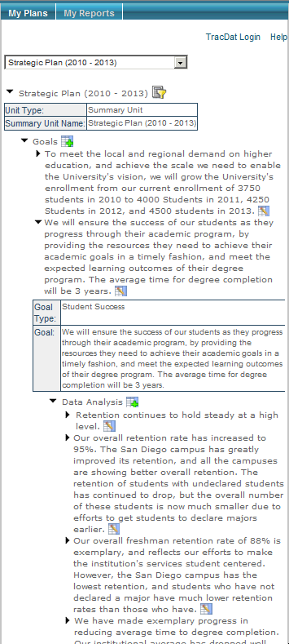
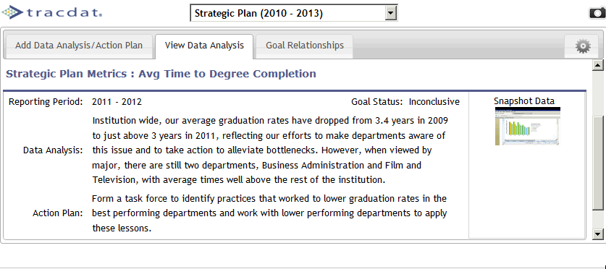
Ellucian Approach to the Challenge (IPM)
Institutional
Data
Strategic Plan
& Outcomes
Engaging Entire Staff

Slide 15
Institutional Best Practice Approach
Actionable Context
People
Planning and Assessment
Data
Culture of Continuous Performance Improvement
Strategic Planning
Academic Outcomes
Administrative Outcomes

Slide 16


Key Components of a Successful Approach
Extend to All Data Systems
2
3
Manage performance
Make decisions
Consolidate data
Align goals
1
4
5
View and discuss data, align to accountability requirements, and make evidence-based decisions that support performance funding.
Help employees track performance against objectives, reflect on progress, submit documents, and determine next steps.
Unite business intelligence reports with your institution’s enterprise resource planning system and track results.
Integrate strategic planning and outcomes information and map that information to your objectives
Academic and administrative key performance indicators across campus, mapped to your objectives on one open and extensible platform, turns performance management into a living process

